Slide 1
Multiple Activities and Intents

Slide 2
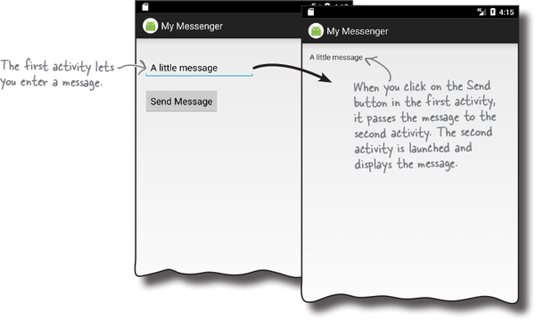
Do I need more than one activity?
We will cover the following:
How to build apps with multiple activities, and how to get your activities talking to each other using intents
How to use intents to go beyond the boundaries of your app and make activities in other apps on your device to perform actions
How to chain multiple activities together to do a task
Notes:
Most apps need more than one activity when things get more complicated
Just having the one activity won’t cut it

Slide 3

Let’s understand it by practice!
Create an app with a single activity and layout
Add a second activity and layout
Get the first activity to call the second activity
Get the first activity to pass data to the second activity

Slide 4
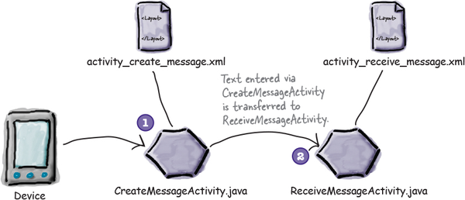
What the app will do?
The app contains two activities and two layouts:
When the app gets launched, it starts activity CreateMessageActivity and uses the layout activity_create_message.xml
When the user clicks a button in CreateMessageActivity, ReceiveMessageActivity is launched, this activity uses layout activity_receive_message.xml
Project name: MyMessenger

Slide 5
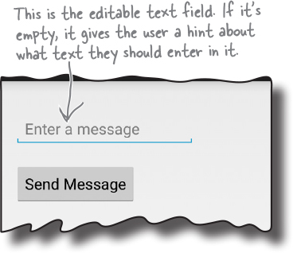
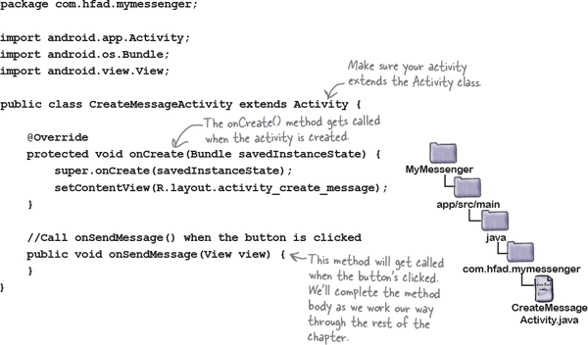
What the app will do?
Use the skills learned in the previous session to design the layout of the activity_create_message.xml as below:
Add a method called onSendMessage to the onClick event
android:onClick="onSendMessage" Add the method to CreateMessageActivity.java as below:

Slide 6
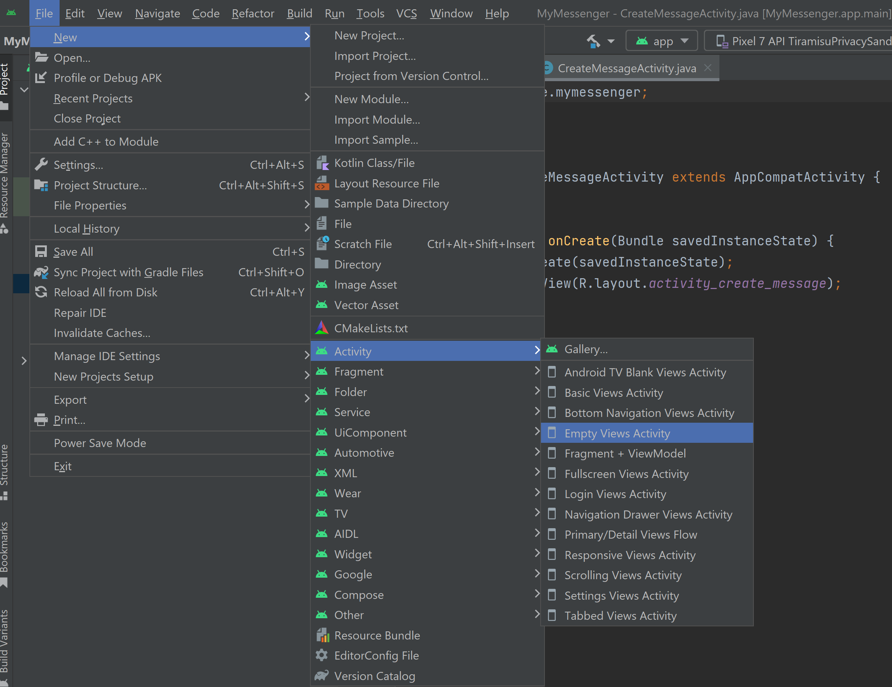
What the app will do?
Add 2nd activity: File → New → Activity and choose the option for Empty Views Activity
You will be presented with a new screen where you can choose options for your new activity
Change the name of the activity to ReceiveMessageActivity and make sure the code language is java

Slide 7
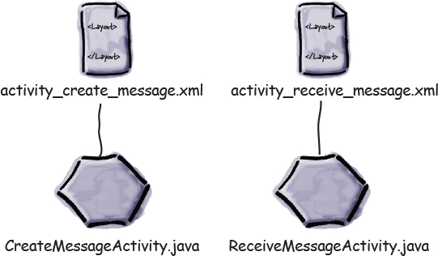
Design The UI for the 2nd activity
Design the activity_receive_message.xml layout as below:
This is a text view filed with a text property assigned to “I am the 2nd activity”
I am the 2nd activity

Slide 8
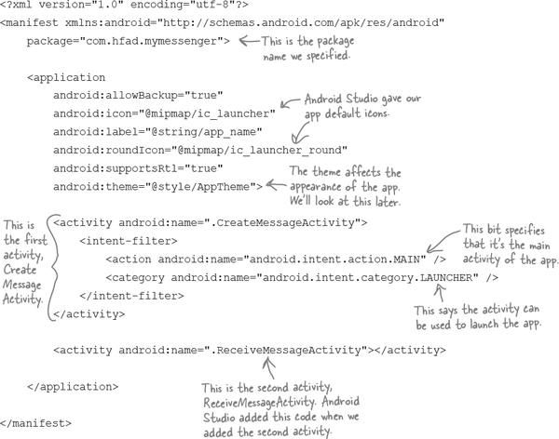
Check Your Android Manifest file
Check your AndroidManifest.xml file, you will have code similar to this:

Slide 9
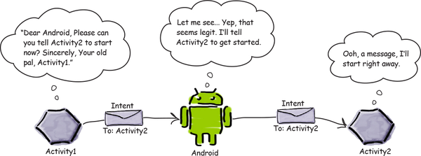
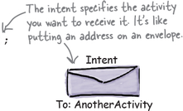

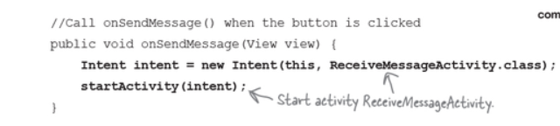
How to call the 2nd activity?
First, create an intent and import Intent class
Second, start the intent
Finally, add the code above to the method onSendMessage() in the 1st activity and run!

Slide 10
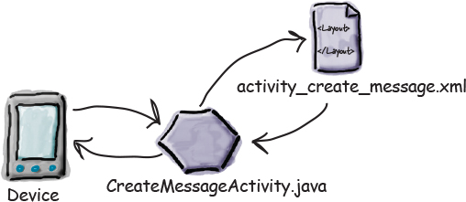
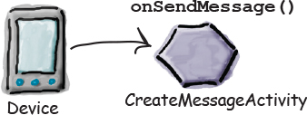
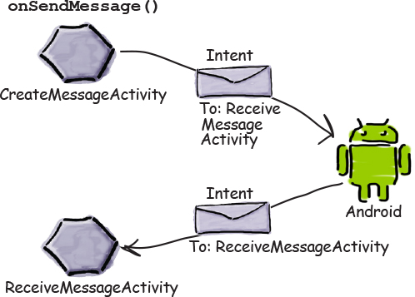
How the app function?
Step 1: When the app gets launched, the main activity, CreateMessageActivity, starts
Step 2: The user types in a message and then clicks on the button
Step 3: The onSendMessage() method uses an intent to tell Android to start activity ReceiveMessageActivity
Step 1
Step 2
Step 3

Slide 11
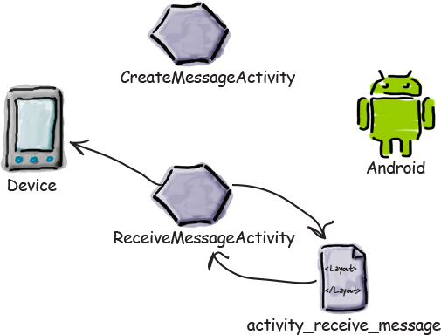

How the app function?
Step 4: When ReceiveMessageActivity starts, it specifies that it uses layout activity_receive_message.xml and this layout gets displayed in a new window
Step 5: Pass the data through intent but how?
Step 4:
Step 5:

Slide 12
Intents (concept)
An intent is a messaging object used to request an action from another app components
Intents are like messages that activate software components (activities, services, broadcast receivers)
An Intent may be explicit when facilitates communication between two components inside the same application
It can be implicit when facilitates communication between two components of different applications
An intent can also be pending, meaning that some component will be activated in the future
It can be broadcast when it announces something to broadcast receivers
Notes:
Explicit intent example: an intent to call another activity in the same app.
Implicit intent example: if your app use another app on your phone such as using opening a link using a browser (not specific).
Broadcast intent is used by Android to send a message to all apps on your phone if you're battery is low.

Slide 13

How to use Intents
An intent is an abstract description of an operation to be performed
It can be used with startActivity(Intent) to launch another Activity
It could be used to start a service/s (open email, web browser, etc.)
It could be used to pass data from one activity to another

Slide 14
Examples: Guess the type?
Activity A launches Activity B
Activity A launches a Service
An activity A wants to perform an action on some data (see contacts)
An activity wants to notify something to the user (see icon in the notification bar)
System notifies some event to ‘all’

Slide 15
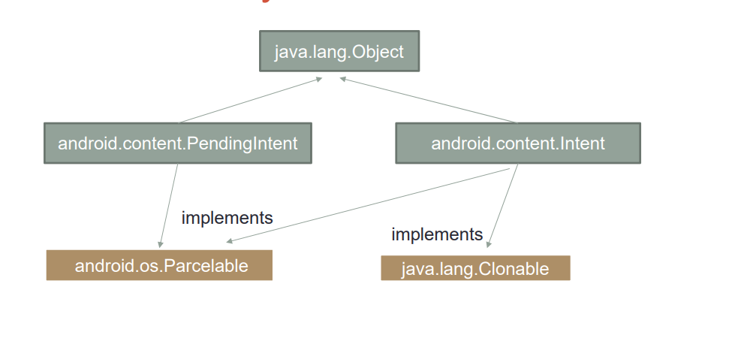
Java Classes

Slide 16
Intent Attributes (java class)
Action:
a string representing the operation (action) to perform
For example: «android.intent.action.MAIN» (it goes in the manifest file)
Referred symbolically in the code as Intent.ACTION_MAIN
Category:
String representing additional information about the component that can manage the intent
For example: «android.intent.category.LAUNCHER»
Symbolically ad Intent.CATEGORY_LAUNCHER
Data:
A URI that references data to operate on (scheme://authority/path)
For example: content://contacts/people/1 Display information about the person whose identifier is "1"

Slide 17
Intent Attributes (java class)
Component: The name of the component to start (used when the component that can handle the intent is known).
Extras: Key-value pairs to carry additional information required to perform the requested action
For example, if the action is to send an e-mail message, one could also include extra pieces of data here to supply a subject, body, etc.
Flags: Behaviours, e.g. don’t push the activity onto the stack, print log, etc.

Slide 18
Passing data to the new activity
1) Create Intent
Intent intent = new Intent();
2) Attach Data
intent.putExtra(key, value);
3) Start Activity
startActivity(intent);
4) Retrieve Data
intent.getStringExtra(key); (String data) or
intent.getIntExtra(key); (Int data)

Slide 19
Passing data via a bundle
Create Intent
Intent intent = new Intent();
Attach Data using bundle
intent.putExtras(bundle);
Start Activity
startActivity(intent);
4) Retrieve Data
Bundle bundle = getIntent().getExtras();
Bundle is used to package complex data into a single object for easier handling

Slide 20
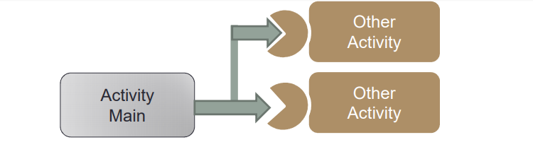
Implicit intents
The Intent doesn’t specify the Activity to start, but only an “Action”
Intents declares their ability to perform actions in the manifest file
There are several predefined actions in the ‘system’ to choose from
A user can define its own action as well
Intent | Android Developers

Slide 21
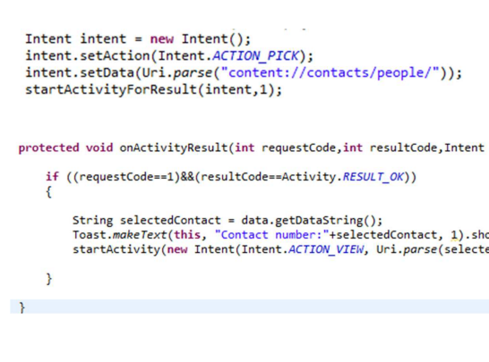
Example: Select a contact
Select a contact from the contact list
Show the contact ID on the screen and view the details

Slide 22
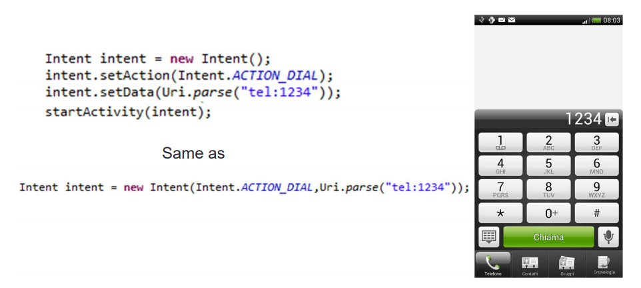
Example: Placing a call

Slide 23
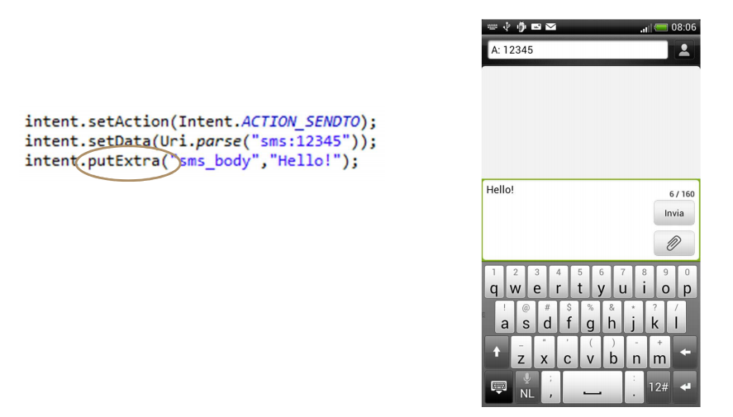
Example: Sending sms

Slide 24
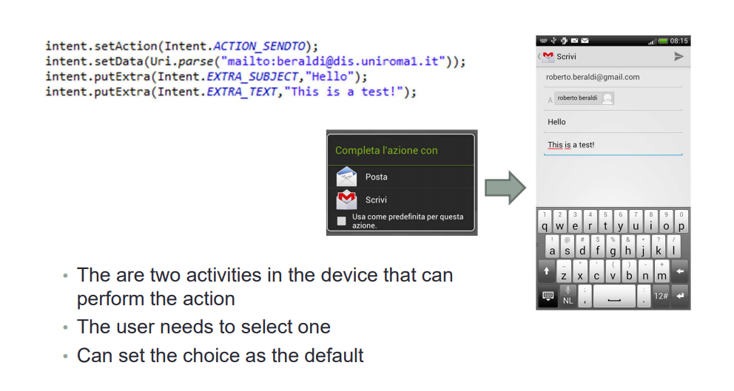
Example: Sending an email

Slide 25
Implicit intent resolution
Action Test
The Intent’s action must be declared in the intent-filter
Category Test
All the categories of the Intent must be declared in the intent-filter, not vice versa
Data Test
The data scheme must be declared in intent-filter
For details see: http://developer.android.com/guide/components/intentsfilters.html

Slide 26

Practice passing data between activities:
Go back to your first example and pass the message written in the first activity to the second using putExtra
You can start the lab 3 tasks which should include step by step instructions to complete the exercise

